Slide 1
HP StoreVirtual VSA

Slide 2
Virtualization growth continues to shape IT
Companies are adopting or expanding virtualization- regardless of size
17.5
15.0
12.5
10.0
7.5
5.0
2.5
0
80% of applications will be virtualized by 2015¹
75% of enterprises have client virtualization on their agenda in next 12 months²
SMB adoption of virtualization 21% to 50% higher than enterprise³
36% of customers currently prefer a fully integrated virtualized solution⁴
Virtual machine
crossover
Millions
2005
2006
2007
2008
2009
2010
2011
2012
2013
Physical hosts Virtual machines
1. IDC, WW Server Virtualization Shipment Forecast, 2005–2013.
2. Gartner, 2012
3 Acronis Global Disaster Recovery Index 2012 survey of SMB IT managers in 18 countries
4. Enterprise Strategy Group - Virtual Computing Infrastructure 2012
Notes:
Virtualization of IT resources delivers a wide range of benefits. It can help an IT organization increase agility, operate more efficiently, cut costs, simplify application deployment and management, improve availability, and establish a foundation for a cloud environment. Benefits like these have turned virtualization into a now-dominant computing paradigm.
It’s clear to see from the statistics just how important virtualization has become and some of the directions it’s taking:
According to IDC, 80% of applications will be virtualized by 2015¹
According to Gartner, VM density per core will rise to 8.4 in 2013²
According to Aconis, SMB adoption of virtualization is 21% to 50% higher than enterprise³
And according to Enterprise Strategy Group, 36% of customers currently prefer a fully integrated virtualized solution⁴
1. IDC, WW Server Virtualization Shipment Forecast, 2005–2013.
2. Gartner, 2012
3 Acronis Global Disaster Recovery Index 2012 survey of SMB IT managers in 18 countries
4. Enterprise Strategy Group - Virtual Computing Infrastructure 2012

Slide 3
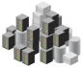






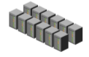
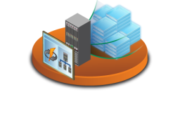

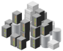








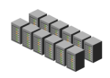





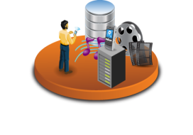


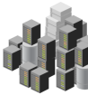



The World Has Changed…
The Storage Silo Era is Over
Most storage deployed today was designed for the needs of 20 years ago
VIRTUALIZATION
NOW 
CLOUD
BIG DATA
3
© Copyright 2012 Hewlett-Packard Development Company, L.P. The information contained herein is subject to change without notice.
Notes:
SLIDE PURPOSE: Start the presentation with setting an expectation that something has to change in the storage world
The storage industry, more than other IT areas, is currently experiencing a major technology change. You probably realize this through the significant amount of startup companies which have evolved in our industry over the past decade with innovations that have reached a maturity level which are now ready for the mainstream market. This can be followed by the significant amount of M&A activites happening not just by HP.
What are the drivers for this?
The last significant technology shift happened 15-20 years ago when storage started to be pooled into SAN solutions, no longer direct attached to server. Most storage systems available today are designed in a monolithic way to cope with the IT requirements of these days (different to reality today):
Application unique IT silos (Virtualization, Utility )
Disparate IT infrastructure (to be converged)
Predictable workloads (more and more unpredictable)
IT-driven timelines (business driven instant demand)
Structured data (unstructured data)
How does storage need to change to cope in this new world?
Storage of next era of computing needs to be designed to excel alongside the 3 megatrends that are driving IT thinking:
An end-to-end virtualized infrastructure
within a IT-as-a-service driven Cloud environment
and with the challenge of Big Data, or even to say ‚Big Everything‘ which accepts that with big data, everything around it gets big as well
Anecdotes:
Big Data: In 2005, we generated 150 exabytes of digital information. In 2010, this volume increased eightfold. We rely on technology to help us process and manage this data, serving it up in consumable chunks. By 2015, the total worldwide cumulative digital archive capacity is projected at 300,000 Petabytes. That’s a lot of chunks
Cloud: In both recessionary times and those of hyper growth, it tends to be technology that drives new buying patterns for goods, lowers barriers to entry for markets, and which provides new opportunities to “leapfrog” over existing business models. For example, new cloud-based service models such as IT-as-a-Service (ITaaS) are driving new purchasing and consumption patterns.

Slide 4

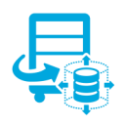

… are you ready for virtualization?
Virtualization
changes the data center
New Challenges
exist that you must solve
Modern Storage delivers essential capabilities
Administrators roles have changed
What is important in our infrastructure is not what it used to be
More flexibility and mobility = greater management burden
Dynamic provisioning requires storage flexibility, efficiency, and high availability
Storage is critical to successful virtualization
Modern architectures can help you optimize, simplify and save your datacenter

Slide 5

The storage challenges of virtualized environments
Customer's infrastructure is:
Ageing and Inflexible
Trapped within a legacy architecture
A mix a platforms makes management complex
Unable to meet the requirements of demand and growth
Budget cuts make hardware changes almost impossible
For an optimal storage solution, customers need:
Simplified management with virtualization integration
Scale-out architecture to grow with demand
Reliable data availability for business continuity
Investment protection as technology and requirements change
Affordable storage platform to fit any budget
Notes:
The storage challenges of virtualized environments
Overview of challenges that customers face with their virtualized infrastructures. (speak to bullets on slide)
When it comes to the storage piece of a virtualized infrastructure, customers are still experiencing challenges that tend to negate the benefits they receive from virtualizing servers.
These challenges may includes ageing, inflexible legacy storage; management complexity; inability to meet user demands or data growth; and limited budget spend.
The optimal storage solution for virtualization should provide simplified management, a scale-out architecture to grow with demand, reliability and high availability and be affordable to fit any budget

Slide 6
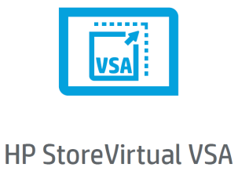
Best-in-class software defined storage for virtualization
Introducing the HP StoreVirtual VSA
Simple
Scalable
Highly Available

Slide 7
HP StoreVirtual VSA

Slide 8
Product Overview
What is VSA?
A virtual storage appliance (VSA) is software-based storage that runs in a virtual machine on a virtualized server. It offers fully featured shared storage that is required by the virtualized applications.
Benefits of VSA
By converging applications and storage on the same server platform, customers gain the benefit of high utilization rates of compute power and storage with high efficiency of power, cooling and data center footprint.

Slide 9
HP StoreVirtual VSA – Why Now?
Performance
Density
Capacity
Virtualization
Today’s media and compute technologies are expanding the scope of services that can be delivered within a modern server infrastructure

Slide 10



The virtualization wave comes to storage
Traditional Infrastructure
Virtual Storage Appliance (VSA)
VM
VM
VM
VM
VM
VM
VM
VM
VM
VM
VM
VM
VM
VM
VM
VM
VM
VM
VM
VM
VM
VSA SC
VM
VM
VM
VM
VM
VM
VM
VM
VM
VM
Servers
VM
VM
VM
VM
VSA SC
VM
VM
VM
VM
VM
VM
VM
VSA SC
VM
VM
VM
Servers with embedded VSAs and added disk
Benefits Provided:
Full set of data services
Highly available
Aggregate performance resources
Shared storage for virtualization
Storage Controller
Storage Controller
Reduce storage costs
20%
Traditional
Benefits
+
Reduce energy costs
60%
Reduce footprint
50%
Storage (NAS or SAN)

Slide 11






Virtual Storage Appliances - HP’s leadership
5 years ago - LeftHand VSA Software created the market of Virtual Storage Appliances
By enabling the convergence of servers and storage, HP LeftHand VSA has:
increased the capacity utilization and efficiency of virtualized servers
created better performing data services
made the server infrastructure flexible through data mobility
As HP LeftHand VSA - Over 12,000 licenses in production today
In Small and Medium businesses, ROBO and service provider environments
Notes:
Over 5 years ago - LeftHand VSA Software created the market of Virtual Storage Appliances and HP still retains that leadership today
By enabling the convergence of servers and storage, the HP VSA:
increases the capacity utilization and efficiency of virtualized servers
creates better performing data services
And makes the server infrastructure flexible through built-in data mobility
More than 4 years ago HP acquired LeftHand Networks and since then the HP LeftHand VSA has over 12,000 licenses in production today in Small and Medium businesses, Remote offices and service provider environments.

Slide 12
Built for virtualization
HP StoreVirtual Technology
Simple
Simple management for virtualized environments
All-inclusive licensing with enterprise-class storage features
Virtualization platform integration for increased functionality and ease of use
Scalable
Non-disruptively scale performance and capacity
One homogenous storage pool with iSCSI connectivity
Highly Available
Proven Five 9’s high availability and reliability
Multi-site disaster recovery with transparent failover
Online data mobility across systems, locations, and technology changes
Notes:
Built for virtualization
To overcome the challenges that customers are facing, HP StoreVirtual is the optimized storage solution that has been built for virtualization.
Simple
Simple management for virtualized environments – An intuitive centralized management console with ease of use in mind allows for visibility of all nodes in the environment and actions to be made in just a few clicks.
All-inclusive licensing with enterprise-class storage features – It includes all features, management, and value-add tools eliminating the need for additional software purchases.
Virtualization platform integration for increased functionality and ease of use – For example, the advanced storage API integration and the HP plug-in modules for VMware vCenter Server and Microsoft Systems Center Operations managers allow administrators to proactively streamline operations with a single console for servers and storage.
Scalable
Non-disruptively scale performance and capacity – A grow-on-demand architecture, StoreVirtual allows nodes to be added to the cluster as needed without disrupting application availability.
One homogenous storage pool with iSCSI and Fibre Channel connectivity – A single pool of shared storage with dual protocol connectivity increases the flexibility of the storage within your environment.
Highly Available
Proven Five 9’s high availability and reliability – the LeftHand Network RAID technology protects the storage and provides applications with continuous data availability even in the event of failures.
Multi-site disaster recovery with transparent failover – Built-in disaster recovery functionality provides seamless application availability with automatic failover and failback across racks, rooms, buildings, or cities.
Online data mobility across systems, locations, and technology changes – migrate volumes across systems or upgrade entire systems with no downtime or disruption to applications.

Slide 13
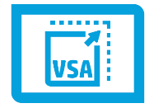
HP StoreVirtual VSA
Enables heterogeneous ITaaS deployments utilizing a software-only scale-out storage solution
Open and extensible to any environment – Any x86 server, multiple hypervisors
Increased agility – seamless data mobility across infrastructure and sites
Resiliency and risk reduction – Built-in backup and disaster recovery
What’s New for StoreVirtual VSA?
New branding – HP StoreVirtual VSA (formerly HP LeftHand VSA)
New lower price – VSA single license at $3500 with 3 year support included – 36% savings
New StoreVirtual VSA Multi-packs – quantities of 15, 60 or 1000 licenses
New capabilities – Double performance with 2 virtual CPUs and multi-threading capability
Notes:
HP StoreVirtual VSA was part of HP’s VMworld news in August 2012 and launched new VSA SKUs in September.
There are three key values of VSA:
It is open and extensible to any environment – VSA can run on any x86 server and multiple hypervisors which include vSphere and Hyper-V
VSA increases agility as it provides seamless data mobility across the infrastructure and multiple sites
It provides resiliency and risk reduction with built-in features such as Network RAID and inherent disaster recovery
In August we pre-announced that performance improvements were coming for VSA. In December, we released those improvements with the LeftHand OS v10.0 software update.
Improvements included the support for a dual core VSA (2 virtual CPUs)
The VSA will include a second virtual CPU in version 10.0 and there is also formal support for adding a second vCPU to existing VSAs (v9.5 and older). This will allow for a significant improvement for some workloads as demonstrated on the next slide.

Slide 14
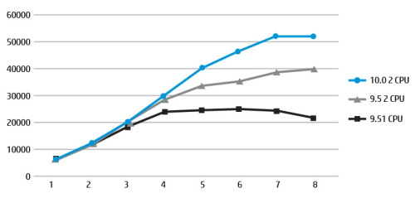

VSA: Prepared for New Demands
Higher performance and capacity to leverage latest technologies
New pricing and services reduce cost by 36% for single licenses
Multi-packs enable large remote office and cloud deployments, for less
3 node VSA cluster with SSDs
IOPS
Queue depth
HP hopes to give itself a shot in the arm with its LeftHand
By Chris Mellor
LHOS enables the StoreVirtual VSA to support two vCPUs. Davis says: "This capability, in addition [to the] multi-threading advancements in 10.0, enhances performance up to 2x for some workloads. As a result of this enhancement, we will now also support running 2 vCPUs in older versions of VSA. So if you’ve been dying to try it, go ahead. Our lab tests with SAN/iQ 9.5 and 2 vCPUs showed an up to 50 per cent increase in performance."
http://www.theregister.co.uk/2012/11/05/hp_storevirtual_storeeasy/
Notes:
Lab testing has demonstrated a significant performance boost resulting from the addition of a second vCPU along with the added capabilities of LeftHand OS 10.0 especially in I/O intensive environments as seen with SSD systems. This slide illustrates a lab test run on a StoreVirtual VSA cluster with 3 vsphere 5.0 nodes, each containing 8 SSD drives. Running a 100% 8k random read workload, we start with a standard 9.5 VSA with a single vCPU. We then add a second vCPU to the 9.5 VSA and then finally we introduce LeftHand OS 10.0. Each step produces a substantial increase in IOPS. With the combination of 2 vCPUs and LeftHand OS 10.0, we see better than 2X increase in IOPS for a grand total of over 50,000 IOPS!

Slide 15
HP StoreVirtual features and integration
All-inclusive feature set
Network RAID – synchronous replication
Peer Motion data mobility
Linear capacity and performance scaling
Pay-as-you-grow, scale capacity and performance as needed, non-disruptively
Space-efficient thin provisioning
Integrated disaster recovery
Snapshots
Remote Copy
Multi-site array
Application integration
vSphere Storage API integration (VAAI, VASA)
VMware vCenter Server storage management
Replication adapter for VMware vCenter Site Recovery Manager
HP Insight Control for Microsoft System Center
HP Management pack for SCOM
VSS provider & requestor functions
LeftHand DSM for MPIO
Application Aware Snapshot Manager
Recovery Manager for Windows
Windows Active Directory
Notes:
In addition to a long list of integrated storage features, StoreVirtual also has many integration points into applications such as vSphere, Hyper-V, Windows, and HP Insight Control management

Slide 16
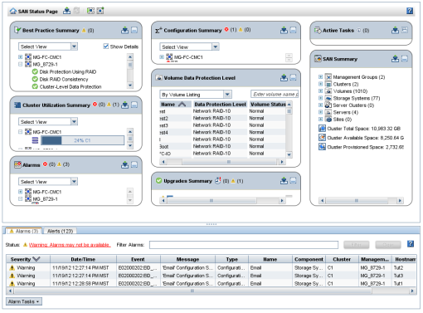
Storage management made simple
Centralized Management Console
Manage all nodes
From all locations
Regardless of model or gen
SAN status page
Real time monitoring
Best practice summary
See available updates
Flexible options
Wizard driven
Manually driven
CLI driven

Slide 17

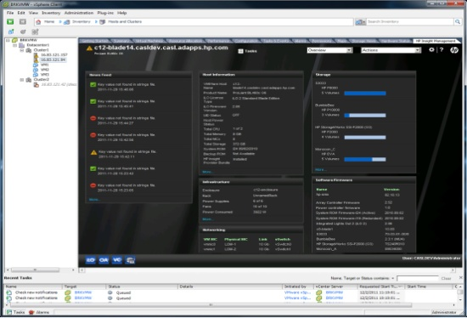
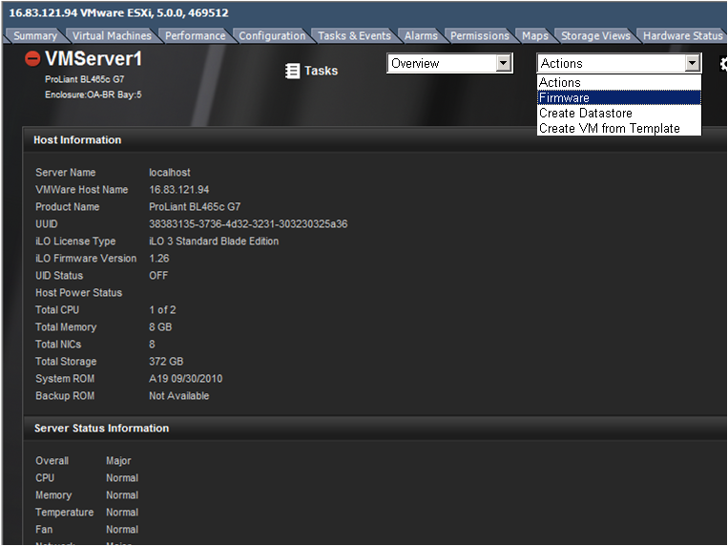
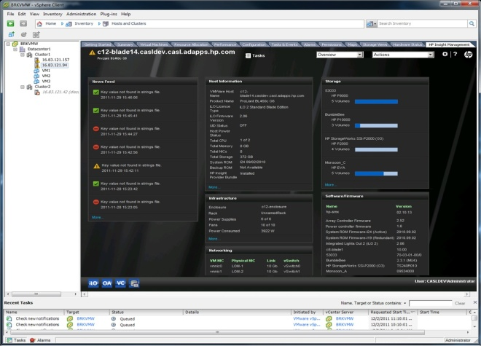


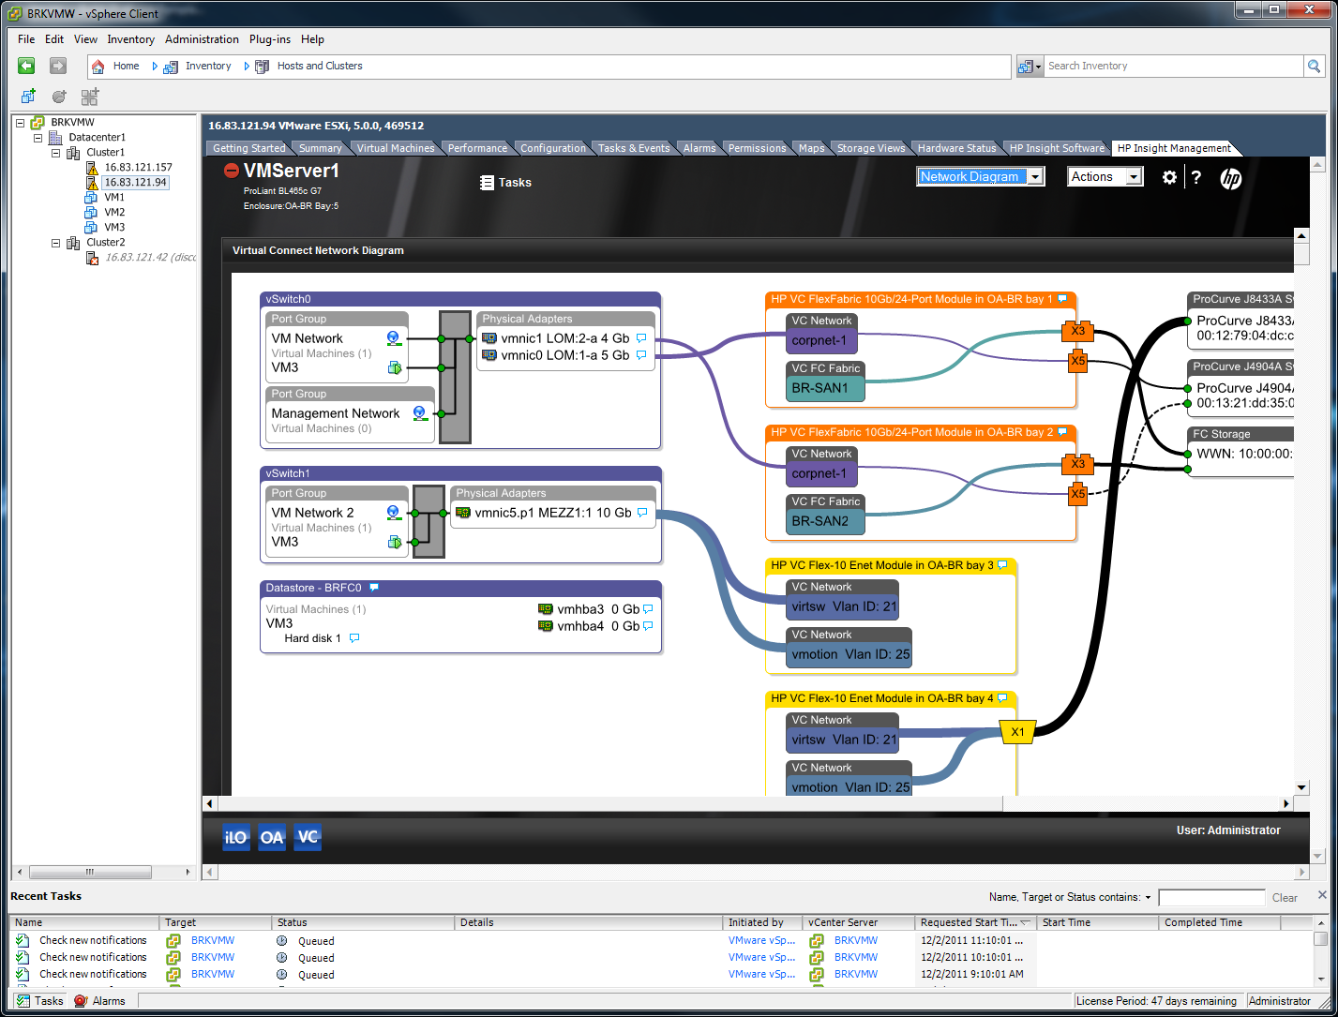

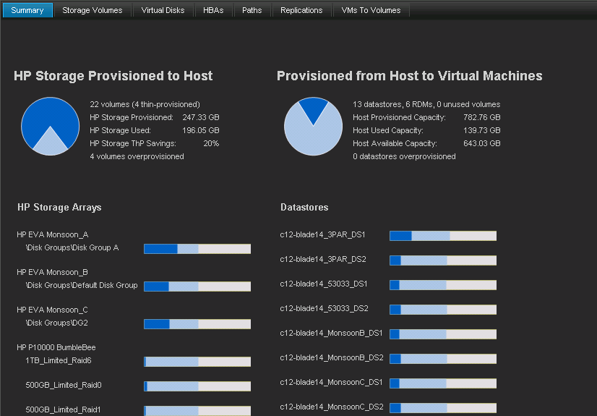
HP Insight Control for vCenter
Single pane of glass from VMware vCenter to your HP Converged Infrastructure
Servers
Management
software
Network
Storage
Notes:
HP Insight Control for vCenter
HP Insight Control Storage Module for vCenter is an HP-developed plug-in module for VMware’s vCenter management console. This enables the VMware administrator to quickly obtain context-aware information about the HP storage in their VMware environment directly from vCenter. This free download provides the VMware administrator the ability to easily see how virtual machines are mapped to data stores and individual disk volumes, as well as create and manage both data stores and virtual machines.
By providing the ability to clearly view and directly manage these relationships between virtual machines, data stores and the HP arrays, the VMware administrator’s productivity increases, as does the ability to ensure quality of service.
Fully compatible with the newest version of VMware -- vSphere 5.1
Monitor and manage the physical/virtual relationships between the VMware Virtual Machines & ESX servers and the HP arrays:
− Understand what storage features are installed in each array
− Understand which storage features are being utilized by what hosts / virtual machines
− Create/Expand/Delete datastores on HP arrays
− Create a Virtual Machine from a template on HP arrays
Includes support for vSphere Storage APIs for Storage Awareness (VASA), which enables vCenter to query and capture the capabilities of HP arrays and make use of the new vSphere 5 Storage DRS and Profile-Driven Storage features.

Slide 18
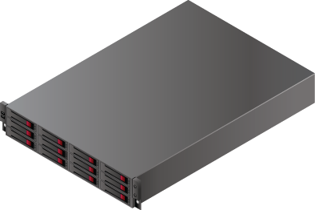
Scalable – HP StoreVirtual adapts to business demands
Add predictable application performance and capacity growth
StoreVirtual features
Non-disruptive and linear scaling of performance and capacity
Start with today’s needs
Grow as needed
Migrate from virtual to physical
Build multi-tiered environment
One homogenous storage pool with iSCSI and FC connectivity
Only product with software, rack and blade versions
Controller
Disks
1or10 GbE NICs
Redundancy
Scalable Storage Pool
IOPS
Notes:
Scalable – HP StoreVirtual adapts to business demands
StoreVirtual Storage is designed with a scale-out architecture, which delivers storage that scales in both capacity and performance linearly, all without disrupting data access. The StoreVirtual array creates a single pool of storage resources comprised from building blocks, which are called storage nodes. Each storage node contributes its own disk drives, RAID controller, cache, memory, CPU, and networking resources to the cluster. Every volume is striped across each node in the cluster, thus leveraging all of their critical resources. The storage software manages each storage node in parallel, so the cluster’s performance increases in lock step with its storage capacity. This means that when you add nodes to a cluster, you get both the performance and capacity to meet your needs.
StoreVirtual now offers one homogenous storage pool with iSCSI and FC connectivity. Dual protocol connectivity is a benefit For customers
With disjointed storage pools across FC and iSCSI networks allowing them to Leverage a single storage architecture for all applications in the enterprise
Standardizing on Ethernet-based technologies
Provide easier migration options when going from Fibre Channel to iSCSI
Looking for all-inclusive enterprise feature set
Only product with Network RAID – provides clustering, replication and high availability - Network RAID is a key component of the LeftHand operating system and is only available from HP
Only product with data mobility across tiers, locations, between virtual and physical – The LeftHand Peer Motion feature allows for volume level mobility across the infrastructure

Slide 19
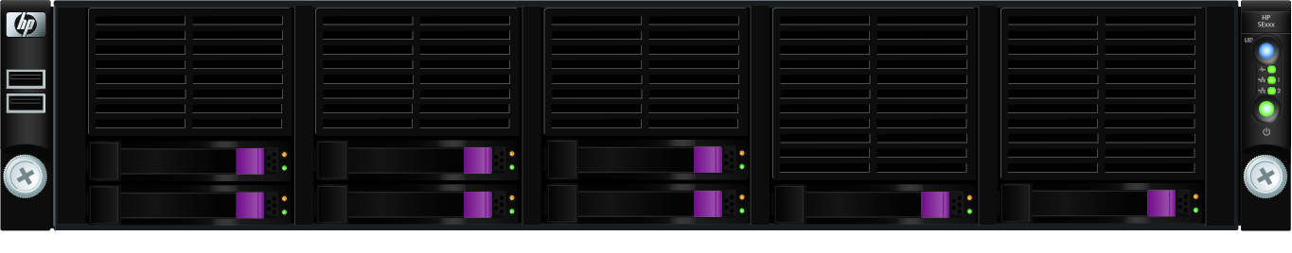
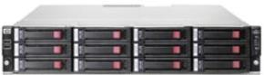
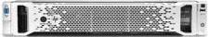
StoreVirtual Peer Motion
Seamless and non-disruptive data mobility
In 6 Clicks – Seamlessly move volumes between:
Systems
Tiers
Locations
Disk types
Form factors
Different generations
Physical and virtual platforms
In a matter of minutes - Swap out/in entire clusters – upgrade technology non-disruptively
All data remains online and available
Peer Motion
Notes:
Seamless and non-disruptive data mobility
Peer Motion is a data mobility technology that allows the movement of volumes across all deployed LeftHand/StoreVirtual nodes regardless of platform or drive type. LeftHand Peer Motion can also swap nodes in and out of a cluster allowing for maintenance or upgrading to new generation technology without scheduled downtime or taking data offline.
Peer Motion Benefits
Offers data and workload movement between storage clusters to address performance and capacity requirements
Enables seamless LeftHand storage technology refreshes, eliminating downtime and/or service interruption during migration/upgrade activities
Promotes federated asset management—by moving data from retiring storage arrays to new storage systems non disruptively
Allows flexible migration of data volumes between multi-site clusters to align with the growing demand for cloud based storage
Enables clients to transparently move application workloads between storage tiers in virtualized and cloud computing environments
Increases return on investment by combining HP thin provisioning and volume migration technology

Slide 20
Best-in-class availability
Five 9’s for mission critical high availability
HP StoreVirtual Storage can sustain multiple concurrent failures and still keep data online and accessible
A unique feature of HP StoreVirtual, Network RAID offers protection above and beyond typical hardware redundancy with a minimum of 2 copies guaranteed to live on different nodes.
All physical capacity is aggregated and is available to all volumes created on the storage cluster, responding to iSCSI requests as a single logical system.
The multi-site stretch cluster feature allows for an entire site to go down with half of the cluster still running with a complete copy of the data at the second site.
vMSC certified – Multi-site configuration is designed to maintain data availability beyond a single physical or logical site and validates full compatibility with the VMware HA features over geographically dispersed sites
Notes:
Best-in-class high availability
Over the last two years, HP has been able to determine from customer reporting that HP LeftHand Storage delivers Five 9’s or greater availability in the field, when configured according to best practices. Five 9’s is equivalent to 5 minutes or less downtime per year.

Slide 21

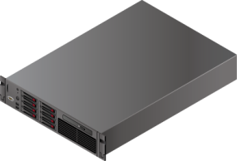



Storage HA for virtualization
Always on storage
Protect data from any SPOF including the array
RAID 10 (Mirror copy)
Mixed workloads (email, DB, virtualization)
Can lose up to half of nodes and data remains available
RAID 5 and 6 (Parity)
Read heavy workloads (file shares)
Storage is as highly available as the VMs
Volume level granularity
Change network RAID levels on-the-fly
Per volume
high availability
NR 5
NR 10
A
B
A
F
C
A
B
D
C
B
P₁
C
D
E
E
D
E
F
Notes:
When it comes to data protection, traditional methods such as HW RAID and redundant components are not enough. Hardware RAID and redundant controllers wont protect your data from human-error, power or cooling issues. Your data must be protected beyond the box, in the event that entire node goes off-line.
P4000 Network RAID allows you to synchronously replicate your data across the nodes in a cluster for high availability. This protection is granular, allowing you to assign it on a per-volume basis. There are several Network RAID protection schemes that you can choose from based on a volume's performance characteristics availability needs.
The first, and most common type is Network RAID 10. In this scheme, the data in a single volume is mirrored across the cluster either 1, 2 or 3 times. The replication occurs real-time, and protects the data from any single point of failure up to, and including, single or multiple storage nodes. Network RAID 10 works well from a performance perspective with mix workloads.
The second type of network RAID is parity based. In this scheme consists of a stripe and parity layout that allows you to start with a few as 3 nodes. This type RAID works best with highly read intensive workloads, like file shares. There is also a dual-parity version called NR6.
It is very flexible by allowing you to change your NR type on the fly when you choose.
21

Slide 22
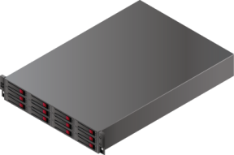
Real-time protection from site failure – Multi-site HA
First iSCSI portfolio & Only VSA product with VMware vMSC certification
Physical separation for protection from:
Component failure
Node failure
Failure in rack
Failure of building
Site or Data Center failure
The next level of HA for virtualized environments
All NR10 volumes are online and accessible simultaneously at both sites
Volumes and VMs remain online in the event of a site failure
Volumes automatically re-sync after failed site comes back online
Site/Rack 1
Site/Rack2
Single cluster
= or > 1 Gb
Single cluster
Data
Remains Online
NR 10
A
D
A
D
A
B
B
A
C
B
C
B
C
D
D
C
Single cluster stretched between two racks, rooms or buildings
Notes:
Real-time protection from site failure – Multi-site HA
HP LeftHand Multi-Site is a feature of the LeftHand operating system. This technology allows for storage clusters to be stretched across sites to provide high availability beyond failure domains defined by the administrator. Traditionally in Metro Storage Cluster configurations, these failure domains are distinct geographic locations, but the technology can be used to protect against the failure of a logical site that may be a rack, room, or floor in the same building as well as buildings within a campus or datacenters that are separated by as much as 100km or more. The Multi-Site feature is part of the all-inclusive StoreVirtual/LeftHand feature set and does not require any special licensing.
The Multi-Site solution uses LeftHand OS Network RAID technology to stripe two copies of data across a storage cluster. When deployed in a Multi-Site configuration, LeftHand OS ensures that a full copy of the data resides on site, or each side of the cluster. Data remains available in the event of a site failure or loss of link between sites.

Slide 23
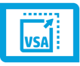
Where to use HP StoreVirtual VSA
Start small then grow
Fully featured shared storage for virtualization
Upgrade to StoreVirtual appliances online
Remote & Branch offices
HA storage for smaller VM environments
Affordable disaster recovery
Testing sandbox
Repurpose existing DAS or SAN
Migrate to production StoreVirtual arrays online
Additional storage tier
Create SSD tiers for high performance
Build from blade or server disks
Cloud Service Providers
Utilize capacity of existing infrastructure
Easily adapt to changing customer demands

Slide 24
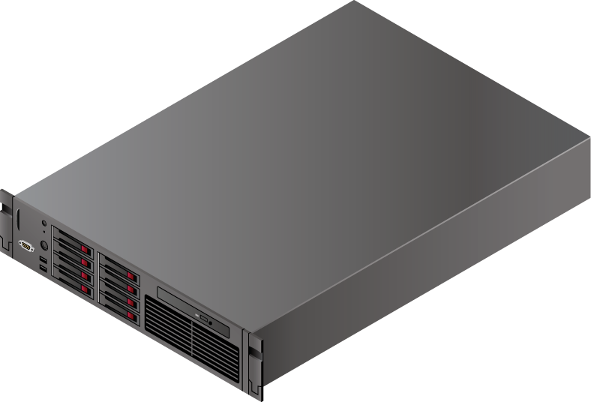
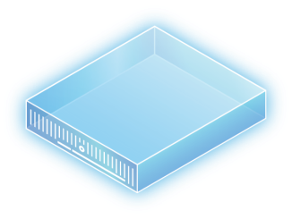


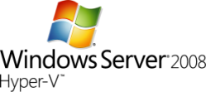

HP StoreVirtual VSA for SMB
Affordable HA and DR for small or remote sites
StoreVirtual VM for vSphere and Hyper-V
Turn servers into fully featured, highly available arrays
Support any server certified for VMware vSphere or qualified for Microsoft Hyper-V
Convert existing direct-attached storage into StoreVirtual Storage
Repurpose existing SAN hardware
VM
VM
NR 5
NR 10
A
A
A
C
B
PB
A
B
PB
C
C
B
Notes:
In addition to StoreVirtual hardware models 4130 and 4330, VSA is another great product for SMB or remote site environments.
As an alternative to adding hardware into an infrastructure, VSA can be used with any VMware or Hyper-V virtualized server benefiting the customer with increased utilization and efficiency of their servers in addition to not requiring extra footprint for storage.

Slide 25
Economics of VSA
Reduce storage costs
20%
Assumptions:
- Similar Server Configs
- HP begins with 3 servers
- Dell begins with 2 servers + storage array
- 15VMs / server & 200GB per VM
Notes:
Price of growth per VM is similar to alternative solutions.

Slide 26
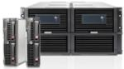
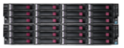
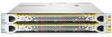

HP StoreVirtual – the versatile platform
Whatever the environment – there’s a StoreVirtual platform that fits
HP LeftHand 4800
Storage for a converged infrastructure
HP StoreVirtual 4130 & 4330 HP LeftHand 4500 & 4900
Consolidate storage on performance or capacity optimized tiers
HP StoreVirtual VSA
ROBO SMB Midsize enterprise
Turn any server into a virtual array
Scale from VSA to BladeSystem as the business grows or use a combination of StoreVirtual platforms – same features, same management
Notes:
In December – the StoreVirtual Portfolio includes VSA, the New 3rd generation 4130 and 4330 models, and the 2nd generation models – P4500, P4900 and P4800
HP StoreVirtual is the most versatile storage platform on the market today as it offers a Virtual Storage Appliance, ProLiant rack and BladeSystem-based hardware models. Scale from one platform to the other, create tiers, or mix and match the product models that best fit the infrastructure for management simplicity and feature consistency.

Slide 27

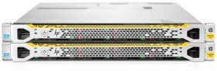
Storage solutions for ROBO sites
An affordable, efficient and easy to manage solution
StoreVirtual VSA and physical platforms let you:
Keep your branches up and running – and critical data available – at all times
Leverage current infrastructure at your remote offices – no additional HW needed
Centralize management to reduce staffing costs, reduce complexity of multiple locations
Have reliable, secure backup and recovery processes
Benefit from high efficiency of power, cooling and footprint
Main Office
StoreVirtual array
VSA
Remote offices
Notes:
Storage solutions for ROBO sites
The combination of VSA and Physical StoreVirtual hardware creates a single storage solution for all locations or departments within a company/school/government entity.

Slide 28
Level Set: Fortune 10 Case Study
Distribution Center Before
-- Traditional Infrastructure --
Distribution Center After
-- Converged Infrastructure --
Windows Server
Windows Server
VM
VM
VM
VM
VM
VM
HP VSA
Windows Server
Windows Server
Windows Server
Windows Server
VM
VM
VM
VM
VM
VM
HP VSA
Windows Server
Windows Server
16 300GB 10k HDDs with RAID 5
Windows Server
Windows Server
VM
VM
VM
VM
VM
VM
HP VSA
Windows Server
Windows Server
16 300GB 10k HDDs with RAID 5
Windows Server
Windows Server
16 300GB 10k HDDs (RAID 5)
14 Dell Servers
Shared networked storage device for clustered application servers (no rack-level HA)
VMware Hypervisor
3 HP DL380 (2U) servers
3 HP StoreVirtual VSAs
Benefits
75% less space and power
Rack-level HA
Easily and predictably scaled: one “brick” at a time
Simply managed: Server /App team not reliant on Storage team
Benefits realized across ~150 sites
Storage Controller
Storage Controller

Slide 29
Power Savings of VSA
Reduce power costs
60%
10,620 W
2.6x
4,160 W
Assumptions:
- Similar Server Configs
- HP begins with 3 servers
- Dell begins with 2 servers + storage array
- 15VMs / server & 200GB per VM
Notes:
Removal of storage array reduces power usage.

Slide 30
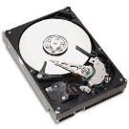
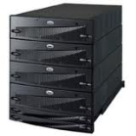
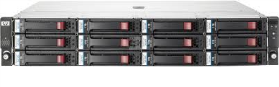
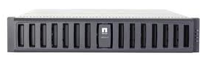
Reduce, Reuse, Recycle
Keep storage acquisitions costs low by repurposing existing hardware
Reduce storage costs
Reuse existing hardware
Recycle existing infrastructure
VSA creates shared storage out of any internal or external disk capacity (DAS, SAN; FC, or iSCSI)

Slide 31
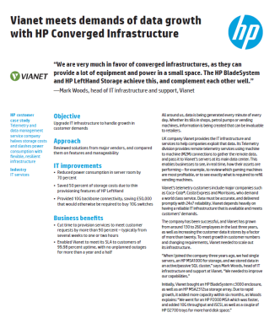
Vianet Case Study
HP’s LeftHand Virtual SAN Appliance software, which enables Vianet to repurpose its existing HP P2000 MSA and D2700 storage at the disaster recovery site.
VSA allows Vianet to create virtual SANs on the HP P2000 MSA which act like a ‘virtual HP LeftHand P4500’, making it easy to replicate the production environment.
“VSA has enabled us to build a truly scalable, flexible storage facility with built in disaster recovery,” says Woods.
Notes:
http://h20195.www2.hp.com/v2/GetPDF.aspx/4AA4-3298ENW.pdf

Slide 32
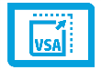
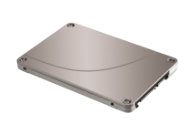
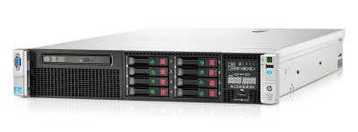



Add a new storage tier
Create Tier 1 Storage with Ease
Add Solid State Disks where needed to quickly address heavy workload demands

Slide 33
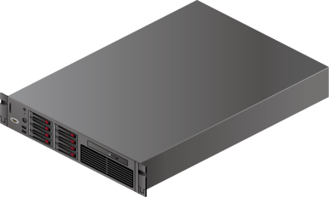

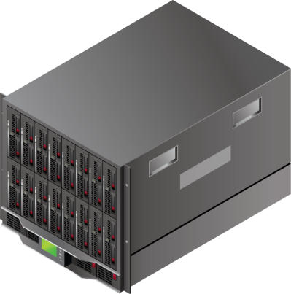

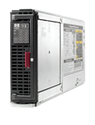
Independent public cloud provider
Benefit from footprint optimization – utilize capacity of existing infrastructure
By adding VSA to a new or existing virtualized server infrastructure, a service provider can:
Add a dynamic, fully-featured storage tier within their server platforms
Optimize efficiency of servers – Footprint optimization, power and cooling savings
Simplify system management
Allow data mobility, to easily adapt to the changing demands of customers
Introduce a new service for customers without growing the infrastructure
VM
VM
D2200sb
Notes:
Independent Public Cloud Provider
An independence public cloud service provider uses standards based servers to build a customized scale out architecture for storage.
VSA is an optimal solution for cloud service provider to add advanced data services into their environment without a heavy uplift. Independent public cloud providers use VSA paired with modular building blocks to deliver new cloud and managed services for customers such as hosted disaster recovery or dedicated storage to match dedicated compute offerings.
For those customers running HP BladeSystem, VSA paired with a D2200sb storage blade is a great way to add shared storage internal to the chassis – a converged infrastructure solution that keeps data traffic internal with the blade servers.

Slide 34
Consolidation of VSA
Reduce footprint
50%
34 U
2.1x
16 U
Assumptions:
- Similar Server Configs
- HP begins with 3 servers
- Dell begins with 2 servers + storage array
- 15VMs / server & 200GB per VM
Notes:
Removal of storage array reduces footprint.

Slide 35
How providers double their services
Storage Services
For managed service providers offering dedicated servers to customers
Add VSA and now offer dedicated server and storage services
Same hardware, same footprint – double the revenue
Backup for SMBs to the Cloud
Offer a new service to SMBs – allow them to replicate their array to your cloud
Cloud provider has StoreVirtual-based cluster (using either VSA or physical arrays)
SMB runs StoreVirtual in their office – send remote snapshots to the cloud

Slide 36
HP StoreVirtual VSA: Summary
World’s most successful VSA
Over 12,000 VSAs in production. Mature technology…5 years running
100% interoperable & federated with StoreVirtual Arrays
DR between Virtual and Physical “SV nodes”. Form a single cluster. Non-disruptively Peer Motion between virtual and physical. Grow from virtual to physical.
The only VSA alternative for Hyper-V
HP Insight Control for MS System Center. VSS provider & requestor functions. DSM for MPIO.
Repurpose other storage capacity
VSA can turn any storage that VMware or Hyper-V “sees” (including NAS & SAN) into its own
Server and hypervisor agnostic
Any x86 server. VMware and MS Hyper-V. Mix and match within the same cluster
Totally VMware ready
HP Insight Control for integrated management. SRM support. vMSC certified. VAAI and VASA. Reference architectures.
VSA Storage isn’t just for VMware or Hyper-V
Export VSA capacity to other operating environments (e.g., a Solaris host, or to OpenStack…really!). Support for iSCSI, SAS, and FC .

Slide 37
Thank you

Slide 38
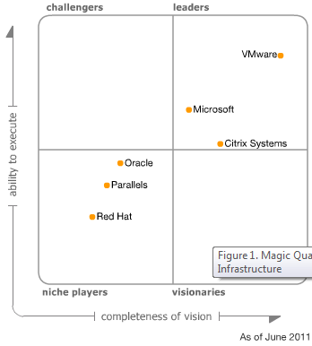
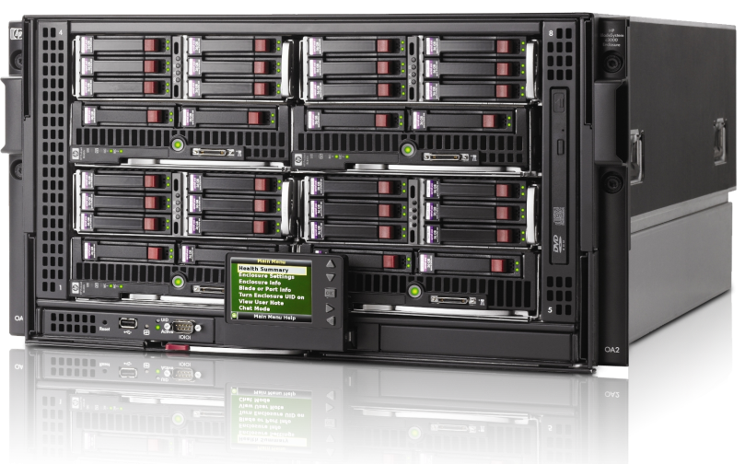
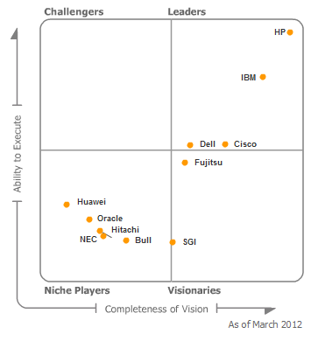
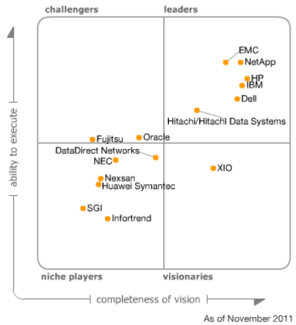

Powerful Positioning: “Most Complete” Modular Cloud
X86 Virtualization
Optimized
Converged storage that is simple, agile and efficient for virtualized environments and tightly integrated with vSphere 5
Performance tested for typical workloads; Exceptional power, cooling, and storage efficiency
HP integrated server, storage, networking management with VMware vCenter Server
Flexible and Designed to Grow
Pay-as-you-grow, don’t need to over purchase server, storage, networking capacity upfront
Support variety of application workloads including virtualized tier 1 applications
Scalable and extensible to the cloud
vCenter automates the management of an increasingly broad pool of datacenter resources and HP Insight is tightly integrated
Blade Servers
Simplified
Preconfigured for a range of customer needs
Easy to order complete virtualized infrastructure
Easy, rapid installation with low risk
Single point of contact for end-to-end support
VMware
+
HP BladeSystem
+
HP StoreVirtual VSA
Midrange Disk Arrays

Slide 39

HP StoreVirtual has best in class vSphere integration
OPTIMIZE
availability & performance
SIMPLIFY
provisioning & management
SAVE
on storage costs
Multi-site storage
vMSC Certification
Peer Motion mobility
VMware VAAI support
vCenter SRM support
Application consistent snapshots
App Aware Snapshot Manager
VMware VASA support
HP Insight Control plug-in for vCenter
Centralized Node Management
All-inclusive SAN software suite
Thin provisioning
Scale-out with storage clustering
Virtual Storage Appliance

Slide 40

HP StoreVirtual has best in class Windows Server and Hyper-V integration
OPTIMIZE
availability & performance
SIMPLIFY
provisioning & management
SAVE
on storage costs
Multi-site storage
Peer motion mobility
Application consistent snapshots
Array snapshot integration with VSS
MPIO support
App Aware Snapshot Manager
Systems Center Management Pack
Centralized Node Management
SCOM/SCVMM support
All-inclusive SAN software suite
Thin provisioning
Scale-out with storage clustering
Virtual Storage Appliance

Slide 41
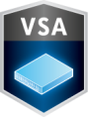
Storage for the Virtual Infrastructure
HP Vision:
The advent of more powerful server platforms and the adoption of solid-state technologies will accelerate the market shift towards a VSA design center for many emerging use cases
App VMs
SAN
NAS
Backup
Hypervisor – your choice
Any Server…any drive type
Software Defined Storage:
Adds flexibility by supporting heterogeneous hardware and hypervisor technologies
Increases agility through seamless data mobility between technologies
Provides value with a variety of storage protocols and data services
HP has a multi-year lead on the competition and a plan to deliver VSA based solutions across other products in the Converged Storage portfolio.

Slide 42
声明：
所有的版权属于原有公司，文件均来自公开渠道
此文件仅供学习使用，任何人不得进行以此为商业目的的行为
如有疑问，请立即删除
学习世界五百强和咨询公司PPT课程请访问如下网站搜索：“司马懿”
百度传课：司马懿PPT学校
网易学堂：司马懿PPT学校
知乎： 司马懿PPT学校
访问地址
https://www.chuanke.com
访问地址
https://study.163.com
访问地址
https://www.zhiu.com

